Slide 1


Data analysis

Slide 2


Today’s
Agenda
Project recap
Problem
The Analytics team
Process
Insights
Summary

Slide 3

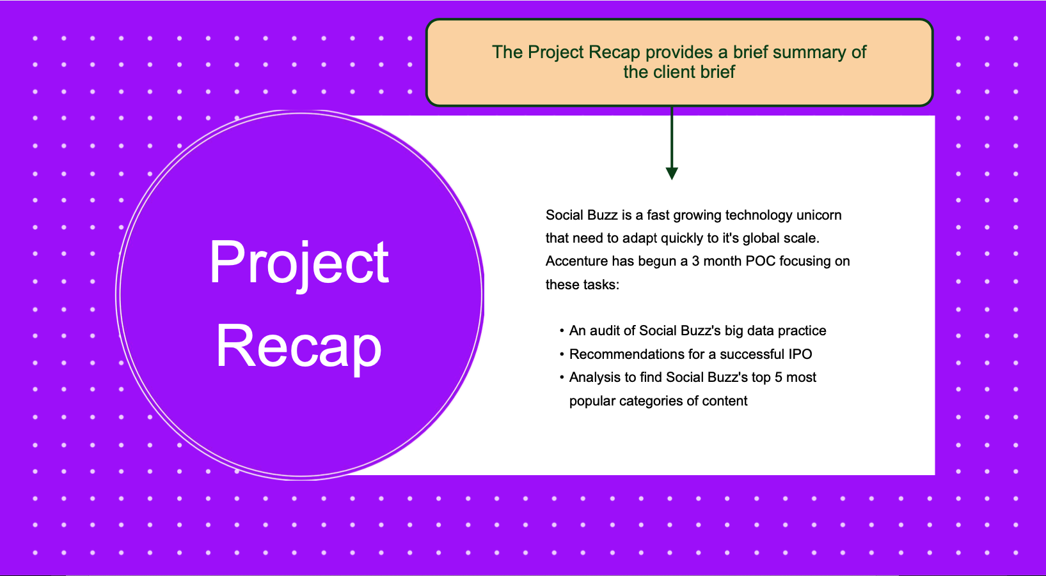
Project Recap

Slide 4

Problem
EVERY SINGLE DAY 100K POSTS ARE SHARED
3.6 M ANNUAL POSTS DIFFICULT TO HANDLE SUCH BIG UNSTRUCTURED DATA
FIND OUT THE TOP 5 CATEGORIES OF CONTENT

Slide 5



Andrew Flaming
Chief Technical Architect
The Analytics team
Marcus Rompton
Senior Principle
JUI ROY
Data analyst

Slide 6
Data
Process
1
DATA UNDERSTANDING
2
DATA CLEANING
DATA MODELING
3
4
DATA ANALYSIS
5
DISCOVER INSIGHTS

Slide 7

Insights
MONTH WITH THE MOST POST COUNT 2138
UNIQUE
CATEGORIES
16
MAY
ANIMAL
Is the most popular category

Slide 9
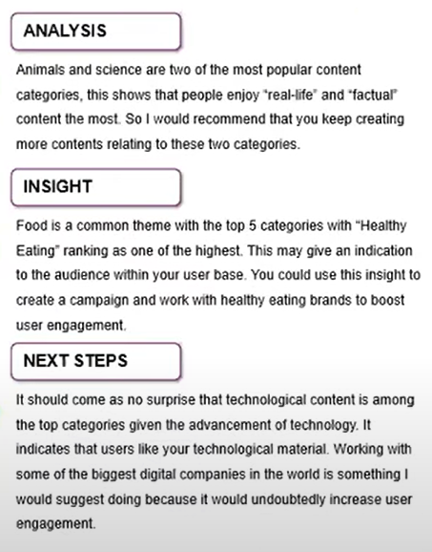

Summary

Slide 10
Thank you!

